Slide 1
Barreleye G2 2.0 OU system Thermal Simulation Report rev. R10
Honda Yan
20170410

Slide 2
System configuration
Component | TDP (watts) | Q’ty. | Note
Power CPU | 225 | 2 | Spec, Tj, 85C
Memory | 5 | 32 | Spec, Tc, 85C
NVMe HDD | 9.0 6.3 | 8 16 | Spec, NAND : Tj, 85C Memory : Tj, 100C Controller : Tj, 125C
K80 | 300 | 2 | Spec, 14.5 CFM
VTM | 66 | 2 | Spec, Tc, 110C
6056 Fan |  | 6
Power Brick | 18.11 | 1 | Flotherm Model provided from vendor

Slide 3
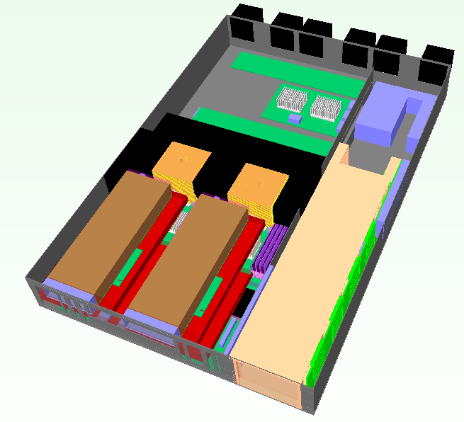
System placement
Fan1
Fan2
Fan3
Fan4
Fan5
Fan6
Expender Board
DIMM x32
VTM
VTM
CPU1
CPU2
2.5” HDD Drawer
Nvidia K80 *2
Power Brick
Air flow direction

Slide 4
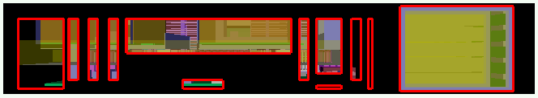

System Inlet / Outlet venting
Venting (open ratio=60%)
Front view
Rear view

Slide 5
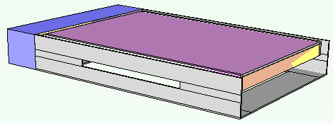
HDD carrier venting
50x3 (mm)

Slide 6
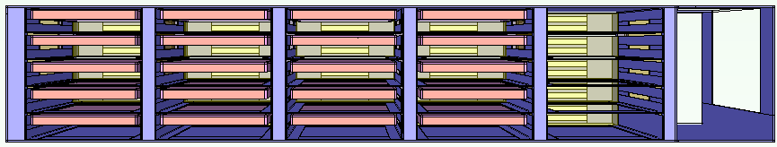
HDDs placement
NVMe HDD with 9.0 watt
NVMe HDD with 6.3 watt

Slide 7
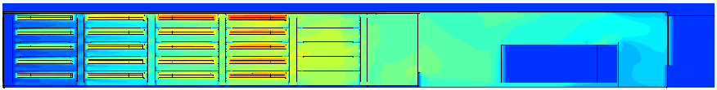
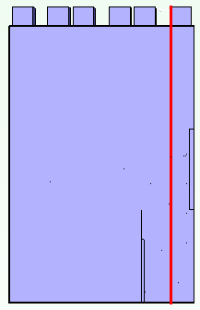

2.5” NVMe HDD Temperature Profile
NAND : 86C
NAND : 93C
* NAND spec : 85C
4x NVMe HDDs with 6.3 watt
can meet spec
3x NVMe HDDs with 9.0 watt
+ 2x NVMe HDDs with 6.3 watt
can meet spec
5x NVMe HDDs with 9.0 watt
can meet spec
X= 470 mm

Slide 8
Conclusion
Conclusion :
After changed HDDs location, x4 NVMe HDD with 9.0 watt can support to 8 pcs.
x2 NVMe HDDs are still support to 10 pcs.

